Slide 1


<Name>
<Date>

Slide 2

Outline
Executive Summary
Introduction
Methodology
Results
Conclusion
Appendix

Slide 3
Executive Summary
This project covers the full data-science pipeline, including data collection, data cleaning, EDA, SQL analysis, interactive visualizations, Dash dashboards, and classification modeling.
The EDA highlights key distributions, trends, and anomalies in the data.
The SQL analysis supplements the statistical indicators, enabling a deeper understanding of the dataset.
Folium and Dash provide interactive tools for exploratory analysis.
Finally, a classification model was built and achieved strong predictive performance on the test data.

Slide 4
Introduction
Dataset Overview:
The dataset was collected through a SpaceX public API using a custom Jupyter notebook. It includes launch records such as mission details, rocket specifications, launch sites, and success outcomes.
The objective is to analyze SpaceX launch data to identify factors related to launch success, extract meaningful insights from exploratory analysis, and build a predictive model that estimates the likelihood of a successful launch.
Key Research Questions:
Which launch features influence success the most?
Can interactive visualizations reveal clear patterns in launch performance?
Can we build a reliable classification model for launch outcome prediction?
Tools Used:
Python, Pandas, SQL, Plotly, Folium, Dash, Scikit-learn.

Slide 5

Section 1

Slide 6
Methodology
Data Collection Methodology
The dataset was obtained by querying the SpaceX public API using a custom Jupyter notebook. The collected data includes launch records, mission details, rocket configurations, launch sites, and outcome labels.
Data Wrangling
The raw API responses were transformed into structured tables. Missing values were handled, categorical fields were standardized, and additional features—such as launch year, orbit category, and success indicators—were created to support later analysis.
Exploratory Data Analysis (EDA)
EDA was conducted using visualizations and SQL queries to examine launch success rates, site performance, rocket characteristics, and temporal trends. This step highlighted key factors that may influence launch outcomes.
Interactive Visual Analytics
Folium was used to map launch locations, enabling spatial exploration of success patterns. A Plotly Dash dashboard was built to provide interactive filtering, trend exploration, and real-time visualization of analytical results.
Predictive Analysis Using Classification Models
A classification model was developed to predict launch success based on available features. The process included model selection, hyperparameter tuning, and evaluation using accuracy and confusion-matrix-based metrics.

Slide 7
Data Collection
1. Queried SpaceX public REST API
2. Retrieved launch records, mission details, rocket configurations, and launch outcome
3. Used Python requests inside a Jupyter notebook
4. Converted JSON responses into Pandas DataFrames
5. Exported structured tables for wrangling, EDA, and modeling
Access SpaceX API
Send GET request
from Jupyter
Receive JSON response
Convert JSON Pandas DataFrame
Clean & standardize fields
Save processed dataset
https://github.com/667788699/IBM-Data-Science-Professional-Certificate/blob/main/Applied%20Data%20Science%20Capstone/Module1/jupyter-labs-spacex-data-collection-api.ipynb

Slide 8
Data Collection – SpaceX API
Key Phrases (How the Data Was Collected)
Retrieved launch data using the SpaceX REST API
Performed HTTP GET requests directly through a Jupyter Notebook
Extracted JSON responses containing launch sites, mission details, rocket info, and launch outcome
Parsed JSON objects into Pandas DataFrames
Combined and cleaned the results to create a structured dataset for EDA and modeling
Notebook includes:
Completed API call code cell
Output display cell showing retrieved launch data
Define SpaceX API Endpoints
Send REST GET Request
Receive JSON Response
Parse JSON → Pandas DataFrame
Clean, Filter, and Select Key Features
Export Final Dataset for Analysis
https://github.com/667788699/IBM-Data-Science-Professional-Certificate/blob/main/Applied%20Data%20Science%20Capstone/Module1/jupyter-labs-spacex-data-collection-api.ipynb

Slide 9
Data Collection - Scraping
Used Python requests to send HTTP GET requests to a public SpaceX data webpage
Retrieved HTML content containing launch records
Parsed HTML using BeautifulSoup to extract tables and relevant fields
Converted extracted data into a Pandas DataFrame
Cleaned, filtered, and merged results with API data for further analysis
Notebook includes:
Code cell performing scraping
Output cell displaying parsed table
Define target URL for scraping
Send HTTP GET request
Receive HTML content
Parse HTML with BeautifulSoup (tables, tags)
Extract launch info → Pandas DataFrame
Clean & integrate scraped fields with API dataset
https://github.com/667788699/IBM-Data-Science-Professional-Certificate/blob/main/Applied%20Data%20Science%20Capstone/Module1/jupyter-labs-webscraping.ipynb

Slide 10
Data Wrangling
Combined API-collected launch records with web-scraped tables
Standardized column names and unified field formats
Converted JSON and HTML tables into structured Pandas DataFrames
Handled missing values and removed irrelevant fields
Derived new features such as launch year, pad location, and success flag
Merged datasets using launch ID as the key
Ensured data consistency before performing EDA and modeling
All wrangling steps were completed and documented in dedicated Jupyter notebooks
Load API dataset (JSON)
Load scraped dataset (HTML)
Normalize column names & data formats
Handle missing / inconsistent data
Convert JSON/HTML → DataFrames
Create derived features (year, site, success)
Merge datasets using launch identifiers
Final clean dataset for EDA & ML
https://github.com/667788699/IBM-Data-Science-Professional-Certificate/blob/main/Applied%20Data%20Science%20Capstone/Module1/jupyter-labs-webscraping.ipynb

Slide 11
EDA with Data Visualization
Exploratory Data Analysis (EDA)
visualize the relationships between launch outcomes and several variables, finding key patterns:
Flight Number: Success likelihood generally increases as the flight number rises, indicating learning and improvement over time (T1, T4).
Launch Site: Noted that VAFB-SLC does not handle heavy payloads (> 10,000 kg) (T2).
Orbit Type: Analyzed success rates across different orbits (T3). Found that success in LEO is related to the number of flights, while GTO shows no clear relationship with flight number (T4, T5).
Yearly Trend: Observed that the average success rate steadily increased from 2013 to 2020 (T6).
Feature Engineering
prepare the data for machine learning models by:
TASK 7: Creating dummy variables (OneHotEncoder) for categorical features: Orbit, LaunchSite, LandingPad, and Serial.
TASK 8: Casting all columns in the final feature set (features_one_hot) to the float64 data type.
https://github.com/667788699/IBM-Data-Science-Professional-Certificate/blob/main/Applied%20Data%20Science%20Capstone/Module2/edadataviz.ipynb

Slide 12
EDA with SQL
Task 1: Display the names of all unique launch sites (Launch_Site).
Task 2: Display 5 records where the launch site begins with the string 'CCA'.
Task 3: Display the total payload mass (PAYLOAD_MASS__KG_) carried by boosters launched for NASA (CRS).
Task 4: Display the average payload mass carried by the booster version F9 v1.1.
Task 5: Query the date when the first successful ground pad landing outcome (Success (ground pad)) was achieved.
Task 6: List the names of the booster versions (Booster_Version) that had a successful drone ship landing (Success (drone ship)) and carried a payload mass between 4000 kg and 6000 kg.
Task 7: Count the total number of successful and failure mission outcomes (Mission_Outcome).
Task 8: Use a subquery to list all booster versions that carried the maximum payload mass.
Task 9: List the records displaying the month, landing outcome, booster version, and launch site for failure drone ship landings in the year 2015.
Task 10: Count the landing outcomes between the dates 2010-06-04 and 2017-03-20, ordered by count in descending order.
https://github.com/667788699/IBM-Data-Science-Professional-Certificate/blob/main/Applied%20Data%20Science%20Capstone/Module2/jupyter-labs-eda-sql-coursera_sqllite.ipynb

Slide 13
Build an Interactive Map with Folium
Map Object | Purpose
folium.Circle | To mark the approximate location of the launch sites.
folium.Marker (Text Label) | To label the name of each launch site.
MarkerCluster | To group many launch outcome markers, simplifying the map.
folium.Marker (Green/Red) | To visually assess success/failure (green/red) rates of each site.
MousePosition | To get coordinates of nearby geographical features (e.g., coastline, railway).
folium.PolyLine | To draw a line between the launch site and a nearby feature to visualize distance.
folium.Marker (Distance Label) | To display the accurate distance to the measured feature.
https://github.com/667788699/IBM-Data-Science-Professional-Certificate/blob/main/Applied%20Data%20Science%20Capstone/Module3/lab_jupyter_launch_site_location.ipynb

Slide 14
Build a Dashboard with Plotly Dash
Component Type | Plot/Interaction Added | Purpose
Input 1 (Interaction) | Launch Site Dropdown Menu (dcc.Dropdown) | Allows the user to filter data by selecting 'All Sites' or a specific launch site for focused analysis of success rates.
Output 1 (Plot) | Success Pie Chart (success-pie-chart) | Visualizes launch success counts. Shows total successes by site (if 'All Sites' selected) or shows the success vs. failure ratio for a specific site.
Input 2 (Interaction) | Payload Range Slider (dcc.RangeSlider) | Enables the user to easily filter the data by Payload Mass (kg) to observe how launch outcomes change across different payload ranges.
Output 2 (Plot) | Success-Payload Scatter Plot (success-payload-scatter-chart) | Visualizes the correlation between Payload Mass (X-axis) and Launch Outcome (Y-axis, or class). Points are color-labeled by Booster Version to investigate its influence.
https://github.com/667788699/IBM-Data-Science-Professional-Certificate/blob/main/Applied%20Data%20Science%20Capstone/Module3/Hands-on%20Lab%20Build%20an%20Interactive%20Dashboard%20with%20Plotly%20Dash.ipynb
Notes:
Summarize what plots/graphs and interactions you have added to a dashboard
Explain why you added those plots and interactions

Slide 15
Predictive Analysis (Classification)
Phase | Description | Key Phrase / Tool Used
Data Preparation | Used the to standardize the features so all data contributes equally to the model. | Data Standardization
Splitting | Split the features and target into training (80%) and testing (20%) sets to ensure the final evaluation is based on unseen data. | Train-Test Split
Model Building & Tuning | Created four different classification models (LR, SVM, Decision Tree, KNN) and used cross-validation to search for the optimal set of hyperparameters. | Hyperparameter Tuning
Evaluation & Selection | Evaluated the optimized models on the separate test data set to determine the final, best-performing model based on accuracy. | Test Set Accuracy Comparison
https://github.com/667788699/IBM-Data-Science-Professional-Certificate/blob/main/Applied%20Data%20Science%20Capstone/Module4/SpaceX_Machine%20Learning%20Prediction_Part_5.ipynb
Notes:
Summarize how you built, evaluated, improved, and found the best performing classification model
You need present your model development process using key phrases and flowchart

Slide 16
Results
Exploratory data analysis results
Interactive analytics demo in screenshots
Predictive analysis results

Slide 17

Section 2

Slide 18
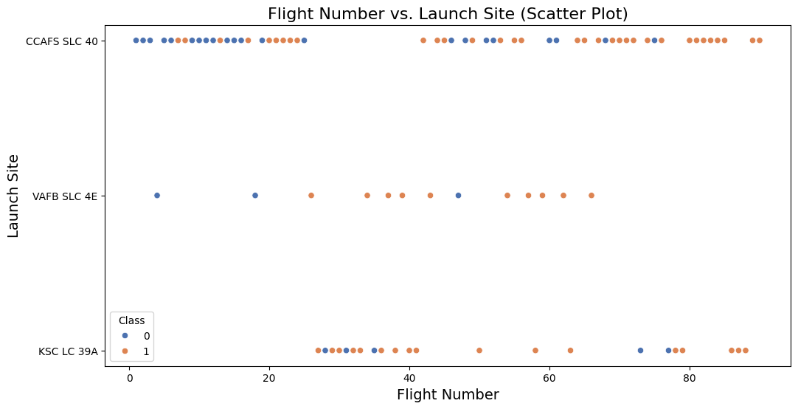
Flight Number vs. Launch Site
Scatter Plot Explanation:
-Each point represents one Falcon 9 launch
.- X-axis: Flight Number (chronological mission progression)
Y-axis: Launch Site- Color: Launch outcome (Class 1 = success, 0 = failure)
- As flight number increases, successful landings become more frequent.

Slide 19
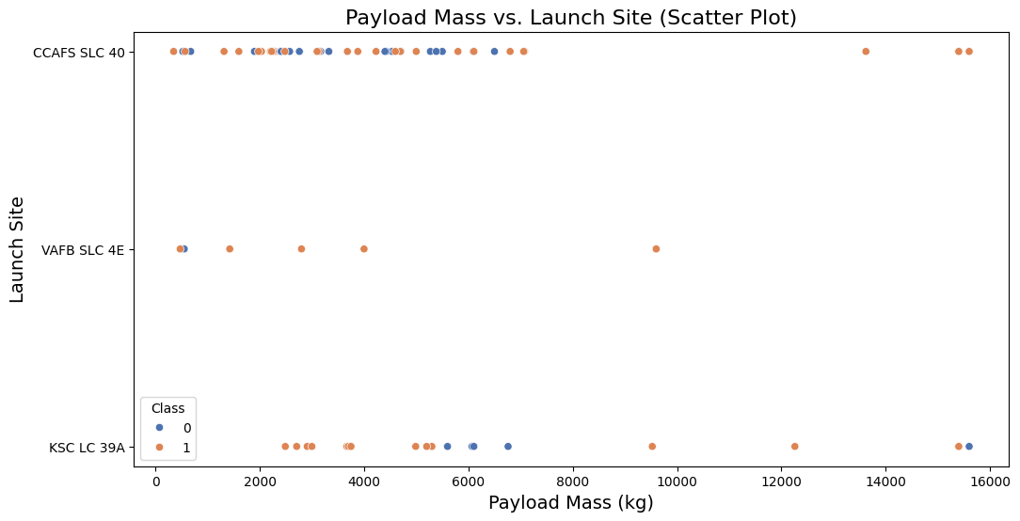
Payload vs. Launch Site
Scatter Plot Explanation:
- Each point represents one Falcon 9 launch.
- X-axis: Payload Mass in kilograms.
- Y-axis: Launch Site.
- Color encodes launch outcome (Class: 1=success, 0=failure).
- Heavier payloads tend to show varied outcomes depending on site.
- Some sites handle a wider payload mass range (e.g., KSC-LC-39A).

Slide 20
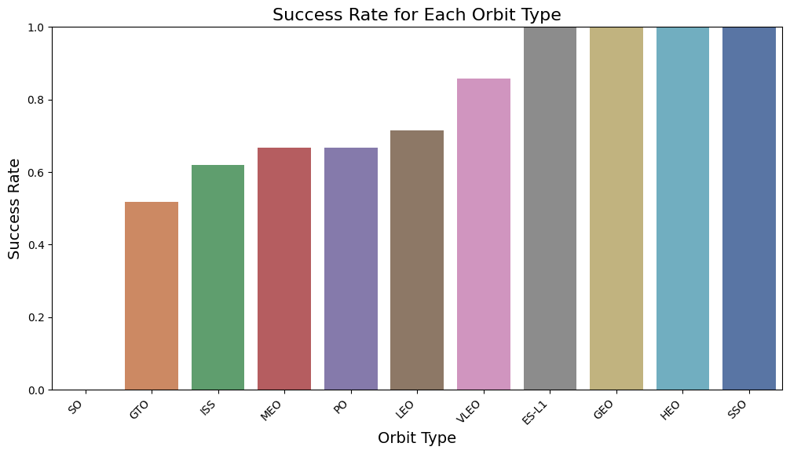
Success Rate vs. Orbit Type
Bar Chart Explanation:
- Each bar represents the launch success rate for a specific orbit type.
- Success rate is calculated as: (successful launches) / (total launches) for that orbit.
- Some orbit types (e.g., GTO or LEO variants) show high launch success consistency.
- Others with fewer launch attempts may show more variability in success rate.
- This visualization helps identify which orbit targets historically have more reliable launch outcomes.

Slide 21
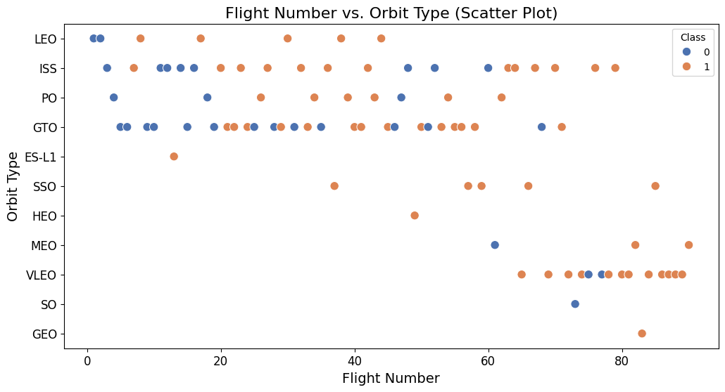
Flight Number vs. Orbit Type
Scatter Plot Explanation:
- Each point represents a Falcon 9 mission.
- X-axis: Flight Number (chronological order of missions).
- Y-axis: Orbit Type (the target orbit for each mission).
- Color encodes launch outcome (Class: 1 = success, 0 = failure).
- Later missions (higher flight numbers) show more consistency in success across various orbit types.
- You can observe which orbits were used more frequently and how success trends changed over time.

Slide 22
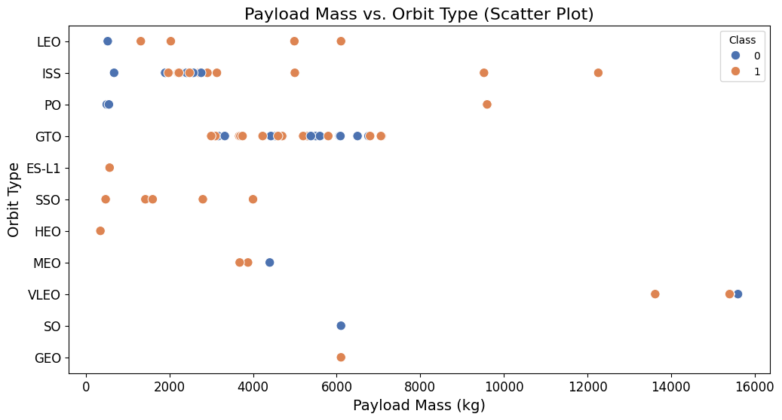
Payload vs. Orbit Type
Scatter Plot Explanation:
- Each point represents one Falcon 9 launch mission.
- X-axis shows the Payload Mass (kg) carried during the mission.
- Y-axis shows the target Orbit Type for that mission.
- Colors indicate launch outcome (Class: 1 = success, 0 = failure).
- Heavier payloads tend to be associated with certain orbit types such as GTO.
- Some orbit types support a wide payload range, while others appear limited.
- The visualization helps compare how payload requirements differ across orbit categories.

Slide 23
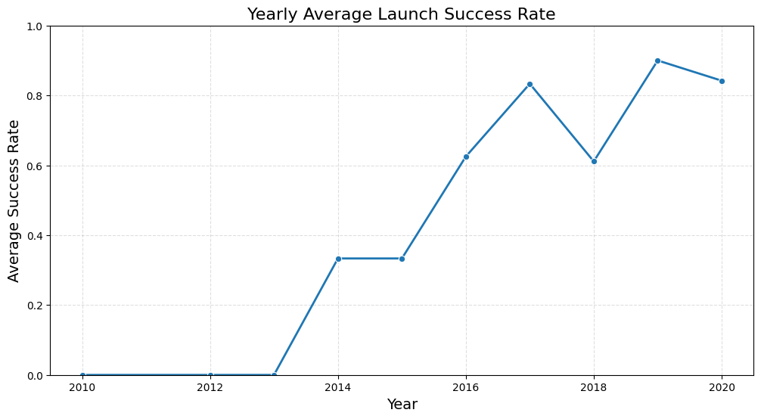
Launch Success Yearly Trend
Line Chart Explanation:
- The line chart shows the average Falcon 9 launch success rate for each year.
- Success rate is calculated as: (number of successful launches) / (total launches) for that year.
- The upward trend across the years reflects SpaceX’s increasing reliability and technological improvements.
- Early years show lower stability, while later years approach near-perfect success.

Slide 24
All Launch Site Names
array(['CCAFS SLC 40', 'VAFB SLC 4E', 'KSC LC 39A'], dtype=object)
The dataset contains launch records from multiple SpaceX facilities. By applying the .unique() function to the LaunchSite column, we extract all distinct launch site names. These four sites represent the major SpaceX ground facilities used for Falcon 9 missions included in this dataset.

Slide 25
Launch Site Names Begin with 'CCA'
FlightNumber | Date | BoosterVersion | PayloadMass | Orbit | LaunchSite | Outcome | Flights | GridFins | Reused | Legs | LandingPad | Block | ReusedCount | Serial | Longitude | Latitude | Class | Year
0 | 1 | 2010-06-04 | Falcon 9 | 6104.959412 | LEO | CCAFS SLC 40 | None None | 1 | False | False | False | NaN | 1.0 | 0 | B0003 | -80.577366 | 28.561857 | 0 | 2010
1 | 2 | 2012-05-22 | Falcon 9 | 525.000000 | LEO | CCAFS SLC 40 | None None | 1 | False | False | False | NaN | 1.0 | 0 | B0005 | -80.577366 | 28.561857 | 0 | 2012
2 | 3 | 2013-03-01 | Falcon 9 | 677.000000 | ISS | CCAFS SLC 40 | None None | 1 | False | False | False | NaN | 1.0 | 0 | B0007 | -80.577366 | 28.561857 | 0 | 2013
4 | 5 | 2013-12-03 | Falcon 9 | 3170.000000 | GTO | CCAFS SLC 40 | None None | 1 | False | False | False | NaN | 1.0 | 0 | B1004 | -80.577366 | 28.561857 | 0 | 2013
5 | 6 | 2014-01-06 | Falcon 9 | 3325.000000 | GTO | CCAFS SLC 40 | None None | 1 | False | False | False | NaN | 1.0 | 0 | B1005 | -80.577366 | 28.561857 | 0 | 2014
We filter the dataset by selecting rows where the LaunchSite column starts with "CCA" using str.startswith("CCA"). This returns all missions launched from Cape Canaveral (CCAFS). Then, we display the first five such records with .head(5).

Slide 26
Total Payload Mass
Total Payload Mass: 619967
Explanation:We summed all values in the PAYLOAD_MASS__KG_ column to compute thetotal payload mass carried across all missions in the dataset.

Slide 27
Average Payload Mass by F9 v1.1
Average payload mass for booster version F9 v1.1: 2534.6666666666665
Explanation:We filtered the dataset for booster version 'F9 v1.1' and computed the meanof the PAYLOAD_MASS__KG_ column. This gives the average payload carried byFalcon 9 v1.1 missions in the dataset.

Slide 28
First Successful Ground Landing Date
Date Landing Outcome24 2016-07-18 Success (ground pad)
Explanation:We filtered the dataset for rows where the 'Landing Outcome' equals'Success (ground pad)'. These represent boosters that successfullylanded on a ground landing zone (e.g., LZ-1). After sorting by date,the earliest successful ground-pad landing is shown above.

Slide 29
Successful Drone Ship Landing with Payload between 4000 and 6000
21 F9 FT B1022
25 F9 FT B1026
38 F9 FT B1021.2
46 F9 FT B1031.2
Name: Booster Version, dtype: object
Explanation:We filtered the dataset to include only launches with successful drone shiplandings and with payload mass between 4000 and 6000 kg. Then we extractedthe unique booster versions that meet these criteria.

Slide 30
Total Number of Successful and Failure Mission Outcomes
Mission outcome counts:class
0 32
1 24
Name: count, dtype: int64
Explanation:The 'class' column represents mission outcome, where 1 indicates successand 0 indicates failure. We used value_counts() to compute the total numberof successful and failed missions in the dataset.

Slide 31
Boosters Carried Maximum Payload
Maximum Payload Mass: 9600.0Boosters that carried this payload:['F9 FT B1029.1' 'F9 FT B1036.1' 'F9 B4 B1041.1' 'F9 FT B1036.2' 'F9 B4 B1041.2']
Explanation:We first identified the maximum payload mass in the dataset.Then we filtered the launches whose payload mass equals this maximum value,and extracted the unique booster versions that carried it.

Slide 32
2015 Launch Records
Booster Version Launch Site Landing Outcome Date
12 F9 v1.1 B1012 CCAFS LC-40 Failure (drone ship) 2015-01-10
15 F9 v1.1 B1015 CCAFS LC-40 Failure (drone ship) 2015-04-14
Explanation:We filtered the dataset for launches from year 2015 where the landing outcomeincludes both 'drone ship' and 'Failure'. Then we extracted booster versions,launch sites, landing outcomes, and dates for these failed drone-ship landings.

Slide 33
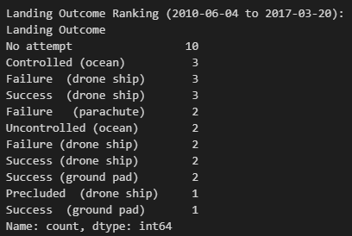
Rank Landing Outcomes Between 2010-06-04 and 2017-03-20
Explanation: We filtered launches within the specified date range, then counted how many times each landing outcome occurred. Finally, we sorted

Slide 34

Section 3

Slide 35
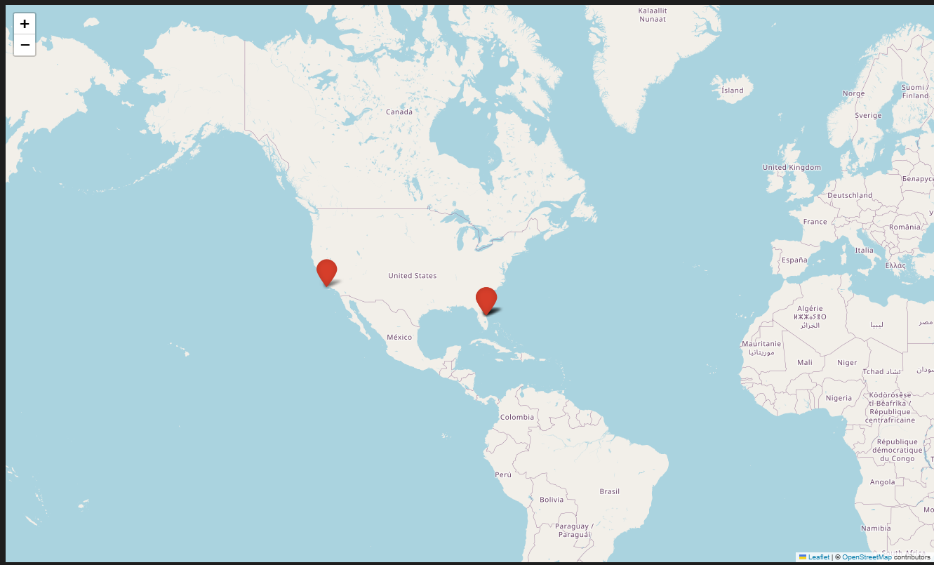
<Folium Map Screenshot 1>
The global map clearly shows that SpaceX’s launch infrastructure is concentrated in the United States, with strategic positioning on both coasts. This distribution allows SpaceX to support a wide variety of mission profiles, from low-Earth orbit to polar and geostationary missions.

Slide 36
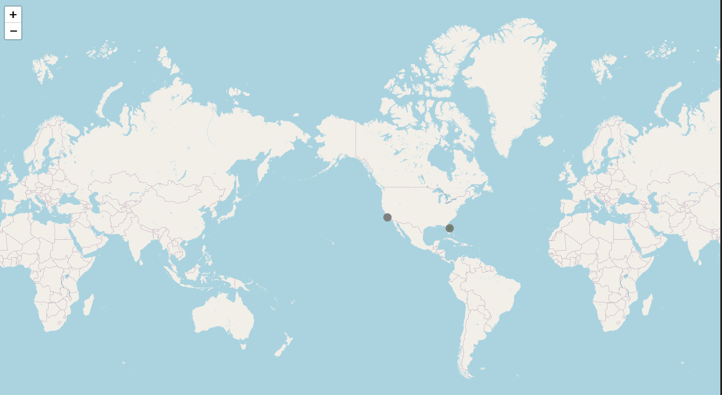
<Folium Map Screenshot 2>
he color-coded folium map clearly illustrates SpaceX’s progression in landing technology. Earlier missions show more red or gray markers (failures or no attempts), while later missions cluster in green, showing improved landing reliability. The map also highlights the concentration of launches on the U.S. east coast, aligning with SpaceX’s mission profile and launch infrastructure.

Slide 37
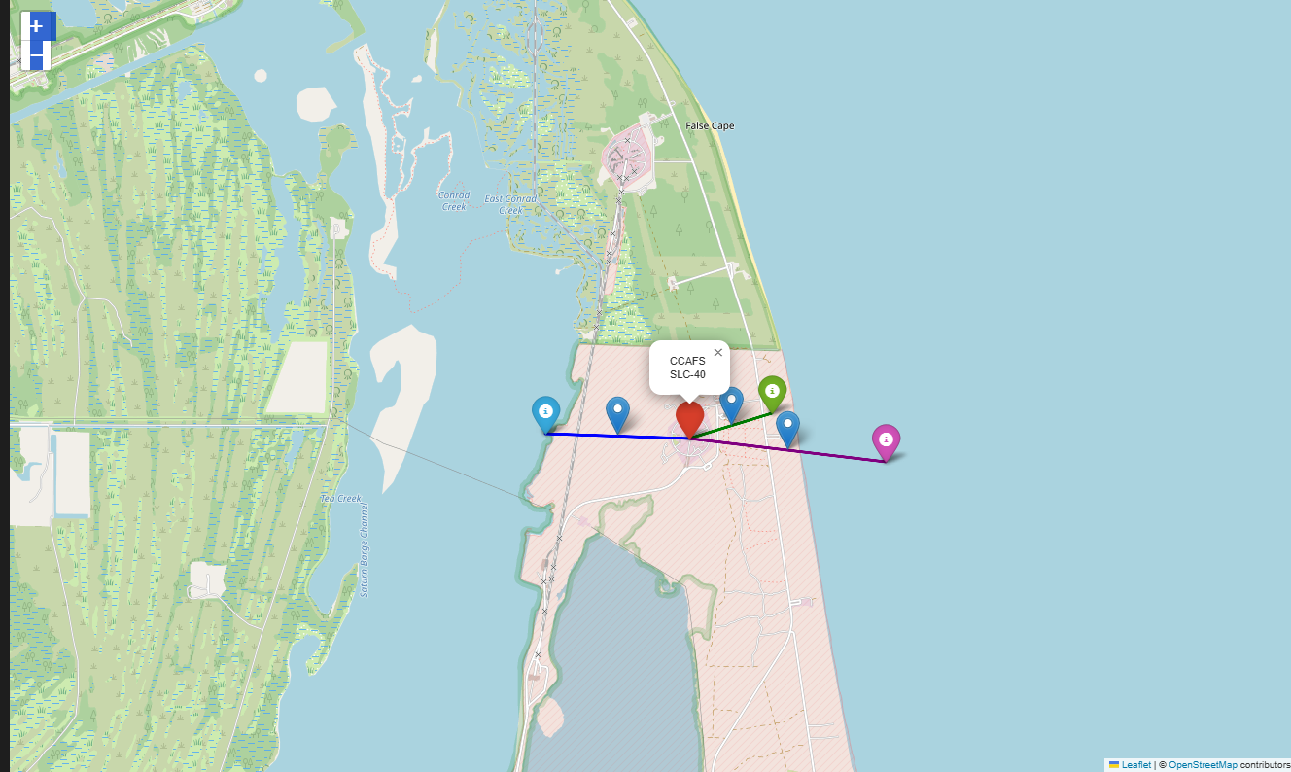
<Folium Map Screenshot 3>
This proximity map shows that infrastructure around SpaceX launch sites is not accidental — transportation access and coastal safety zones play a critical role in mission operations. The visual distances help contextualize how the site supports launch logistics and minimizes risk to surrounding areas.

Slide 38

Section 4

Slide 39
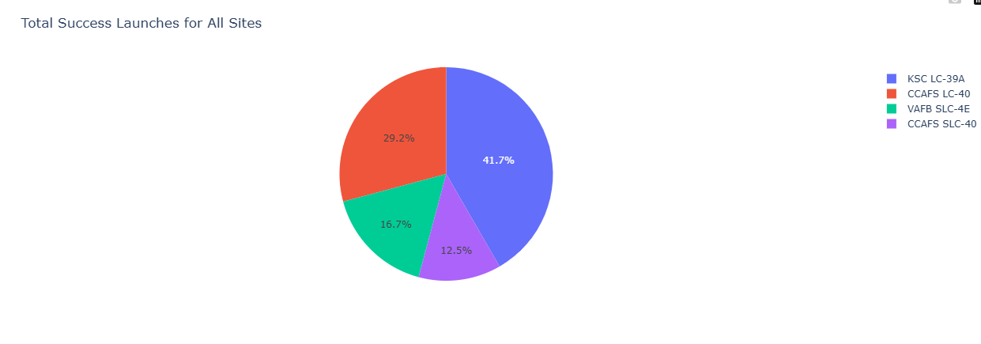
<Dashboard Screenshot 1>
The pie chart shows how many successful launches each SpaceX launch site achieved. KSC LC-39A accounts for the largest share of successful missions, while the other sites contribute smaller portions. This visualization helps compare overall launch success among all sites at a glance.

Slide 40
<Dashboard Screenshot 2>
This pie chart shows the success and failure distribution for the launch site with the highest success ratio. The site demonstrates a strong dominance of successful missions, indicating reliable performance and consistent launch outcomes. The chart highlights how few failures occurred compared to successes, reinforcing why this site ranks highest in success rate.

Slide 41
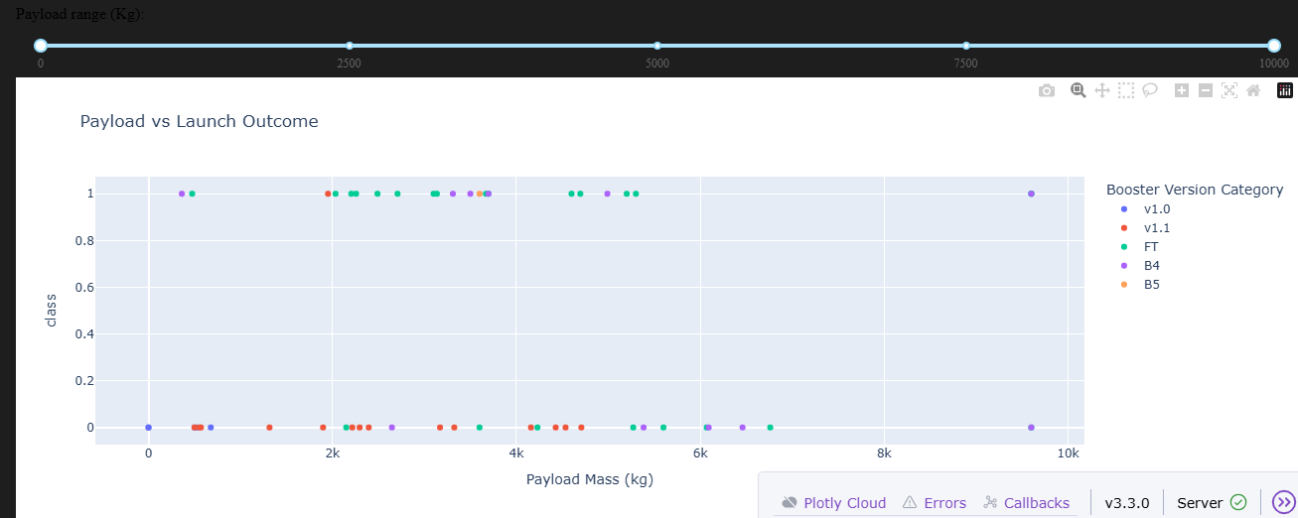
<Dashboard Screenshot 3>
The scatter plot shows how payload mass relates to launch success. Most successful launches occur in the mid-range payload (around 2000–6000 kg). Booster versions such as FT show more successful points, indicating higher reliability. Different payload selections mainly change point density but the success pattern remains similar.

Slide 42

Section 5

Slide 43
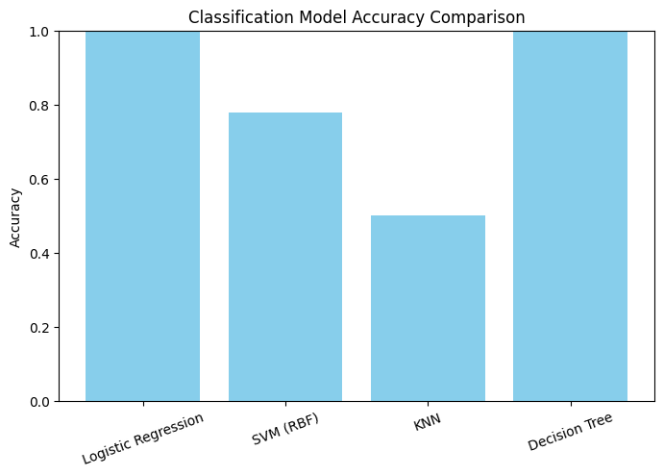
Classification Accuracy
Best Model: Logistic Regression with accuracy 1.0000

Slide 44
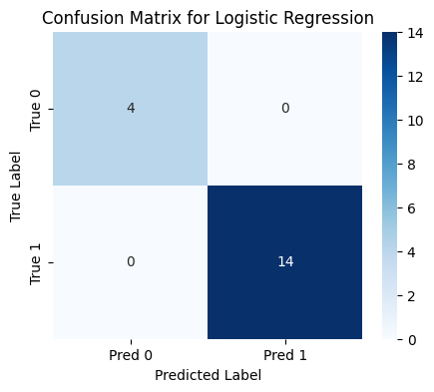
Confusion Matrix

Slide 45
Conclusions
This project combined data collection, exploratory analysis, geospatial visualization, interactive dashboarding, and machine learning to understand factors influencing SpaceX Falcon 9 launch success. The analyses showed clear improvements in launch reliability over time, identified payload ranges and booster versions associated with higher success rates, and highlighted performance differences across launch sites. The final classification model achieved strong predictive accuracy, demonstrating that launch outcomes can be effectively modeled using the engineered features.

Slide 46
Appendix
Include any relevant assets like Python code snippets, SQL queries, charts, Notebook outputs, or data sets that you may have created during this project

Slide 47


